Slide 1
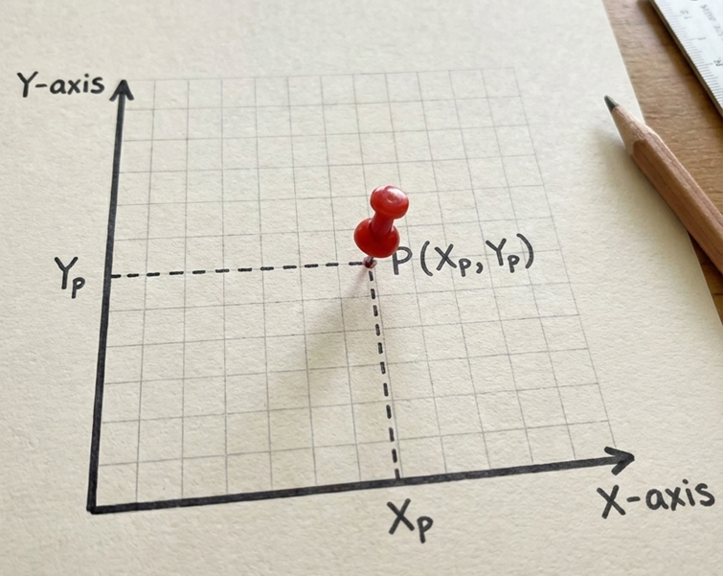
Summary of Lesson
✅Circle
patches.Circle((Xp, Yp), radius=r, facecolor=“colorname")
✅Rectangle
patches.Rectangle((Xp, Yp), width=w, height =h, facecolor=“colorname", angle=degree)
✅ Ellipse (Oval)
patches.Ellipse((Xp, Yp), width=w, height=h, facecolor="colorname“, angle=degree )
✅ Regular Polygon
patches.RegularPolygon((Xp, Yp), numVertices=n, radius=r, facecolor="colorname“, angle =degree )

Slide 2
Single for loop
for i in range(start, stop, step):
instruction_1
instruction_2
Important Notes:
  Indentation matters: All instructions inside the loop must be indented.
  Ending the loop: Stop indenting to exit the loop. The next line aligned to the left is outside the loop.
  range(start, stop, step) generates numbers (integer) from start to stop, incrementing by step.

Slide 3
Nested for loops
for i in range(start-1, stop-1, step-1):
instruction_1
instruction_2
for j in range (start-2, stop-2, step-2):
instruction_2
instruction_2
Important Notes:
  Indentation matters: All instructions inside the loop must be indented.
  Ending the loop: Stop indenting to exit the loop. The next line aligned to the left is outside the loop.
  range(start, stop, step) generates numbers (integer) from start to stop, incrementing by step.
-

Slide 4
Nested for loops vs Sequential for loops
for i in range(start-1, stop-1, step-1):
instruction_1
instruction_2
for j in range (start-2, stop-2, step-2):
instruction_2
instruction_2
for i in range(start-1, stop-1, step-1):
instruction_1
instruction_2
for j in range (start-2, stop-2, step-2):
instruction_2
instruction_2

Slide 5
Nested for loops vs Sequential for loops
for i in range(start-1, stop-1, step-1):
instruction_1
instruction_2
for j in range (start-2, stop-2, step-2):
instruction_2
instruction_2
Nested for loops runs one loop inside another loop. Inner loop repeats every time the outer loop runs once.
for i in range(start-1, stop-1, step-1):
instruction_1
instruction_2
for j in range (start-2, stop-2, step-2):
instruction_2
instruction_2
Sequential for loops run one after another.

Slide 6

Access Computer
💻 Login to the Computer
    Username: .\guest
    Password: Carbondale!
🚀 Launching Python Jupyter Notebook
Click the Jupyter icon in the bottom menu to
launch Jupyter Notebook.
Once it opens, you are ready to begin coding!

